Slide 1
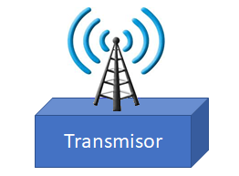

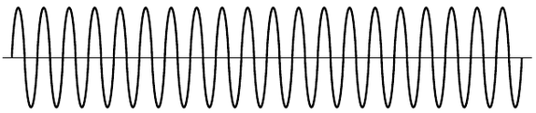


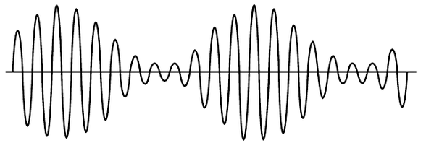
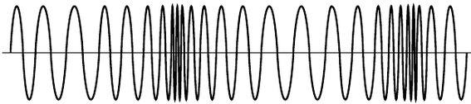
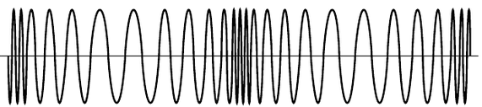






Sistema de Comunicaciones
Medio de Transmisión
Portadora o Carrier
$$p\left(t\right)={V_{P}}_{c}\operatorname{sen}\left(2πf_{c}t\right)$$
Frecuencia de Transmisión
Receptor
Moduladora
$$f_{c}≫f_{m}$$
Señal de Información
m$\left(t\right)={V_{P}}_{m}\operatorname{sen}\left(2πf_{m}t\right)$
Modulación de Amplitud
Modulación de Frecuencia
Modulación de Fase
$$\left[{V_{P}}_{c}\text{m}\left(t\right)\right]\operatorname{sen}\left(2πf_{c}t\right)$$
$$\left[{V_{P}}_{c}\right]\operatorname{sen}\left(2π\left[f_{c}+\text{m}\left(t\right)\right]t\right)$$
$$\left[{V_{P}}_{c}\right]\operatorname{sen}\left(2πf_{c}t+\text{m}\left(t\right)\right)$$

Slide 2
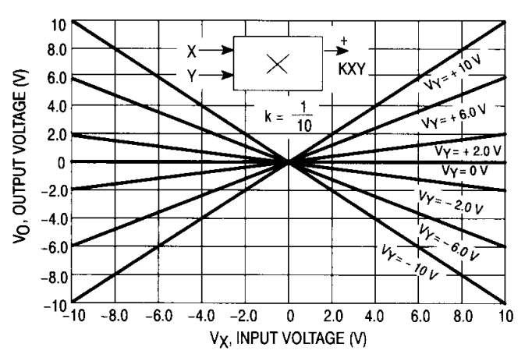



Modulación de Amplitud (AM)
Moduladora
X
$${V_{P}}_{c}{V_{P}}_{m}\operatorname{sen}\left(2πf_{m}t\right)\operatorname{sen}\left(2πf_{c}t\right)$$
m$\left(t\right)={V_{P}}_{m}\operatorname{sen}\left(2πf_{m}t\right)$
Portadora o Carrier
$$p\left(t\right)={V_{P}}_{c}\operatorname{sen}\left(2πf_{c}t\right)$$
100 estaciones espaciados en 10 KHz
Radio América
Radio Cartago
Radio CR
Cú Cú
FCN
Radio 16
530 KHz
700
780
850
930
1200
1590
1600 KHz

Slide 3
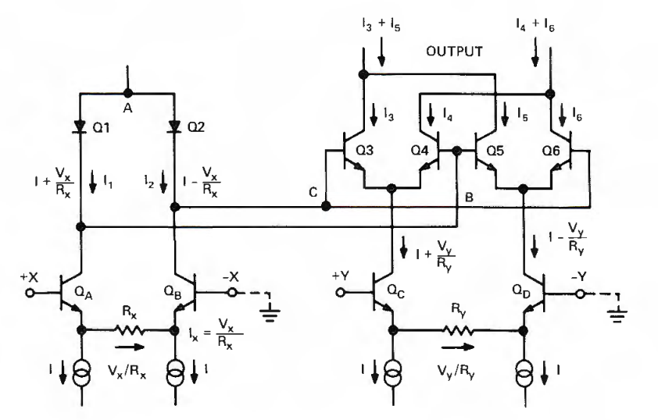


$$I_{o}=\frac{2}{I}\frac{V_{x}V_{y}}{R_{x}R_{y}}$$
$$I_{D}=I_{R}e^{\frac{V_{D}}{V_{T}}}$$
*ADI_Multiplier_Applications_Guide

Slide 4
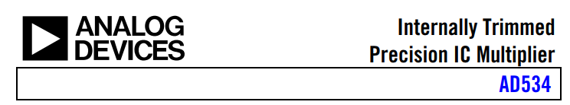
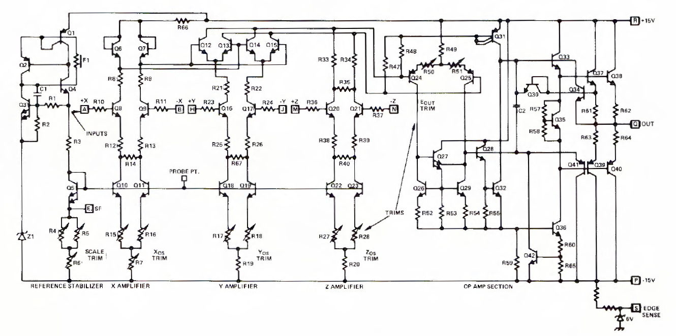
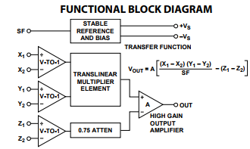

Slide 5

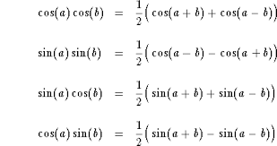
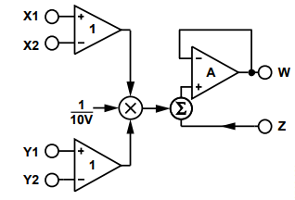




Moduladora
m$\left(t\right)={V_{P}}_{m}\operatorname{sen}\left(2πf_{m}t\right)$
$$\frac{{V_{P}}_{c}{V_{P}}_{m}}{10}\operatorname{sen}\left(2πf_{m}t\right)\operatorname{sen}\left(2πf_{c}t\right)$$
Portadora o Carrier
$$p\left(t\right)={V_{P}}_{c}\operatorname{sen}\left(2πf_{c}t\right)$$
$$\frac{{V_{P}}_{c}{V_{P}}_{m}}{20}\cos\left(2π\left[f_{c}−f_{m}\right]t\right)−\frac{{V_{P}}_{c}{V_{P}}_{m}}{20}\cos\left(2π\left[f_{c}+f_{m}\right]t\right)$$

Slide 6








$$\frac{{V_{P}}_{c}{V_{P}}_{m}}{20}\cos\left(2π\left[f_{c}−f_{m}\right]t\right)−\frac{{V_{P}}_{c}{V_{P}}_{m}}{20}\cos\left(2π\left[f_{c}+f_{m}\right]t\right)$$
$$V$$
$$f_{m}=5 kHz$$
$$f_{c}=1200 kHz$$
Frecuencia lateral Inferior $$1195 kHz$$
Frecuencia lateral superior
$$1205 kHz$$
$$f$$
Modulación Balanceada o con portadora suprimida
(DSB-SC: Double-sideband suppressed-carrier)
$$t$$
100 estaciones espaciados en 10 KHz
Radio América
Radio Cartago
Radio CR
Cú Cú
Frecuencia audible:
20 Hz – 20 KHz
FCN
Radio 16
Graves
Agudos
530 KHz
700
780
850
930
1200
1590
1600 KHz

Slide 7
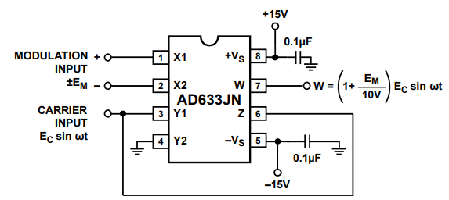




Moduladora
m$\left(t\right)={V_{P}}_{m}\operatorname{sen}\left(2πf_{m}t\right)$
$$\frac{{V_{P}}_{c}{V_{P}}_{m}}{10}\operatorname{sen}\left(2πf_{m}t\right)\operatorname{sen}\left(2πf_{c}t\right)+{V_{P}}_{c}\operatorname{sen}\left(2πf_{c}t\right)$$
Portadora o Carrier
$$p\left(t\right)={V_{P}}_{c}\operatorname{sen}\left(2πf_{c}t\right)$$
$$\left[1+\frac{{V_{P}}_{m}}{10}\operatorname{sen}\left(2πf_{m}t\right)\right]{V_{P}}_{c}\operatorname{sen}\left(2πf_{c}t\right)$$
$${V_{P}}_{c}\operatorname{sen}\left(2πf_{c}t\right)+\frac{{V_{P}}_{c}{V_{P}}_{m}}{20}\cos\left(2π\left[f_{c}−f_{m}\right]t\right)−\frac{{V_{P}}_{c}{V_{P}}_{m}}{20}\cos\left(2π\left[f_{c}+f_{m}\right]t\right)$$

Slide 8




$${V_{P}}_{c}\operatorname{sen}\left(2πf_{c}t\right)+\frac{{V_{P}}_{c}{V_{P}}_{m}}{20}\cos\left(2π\left[f_{c}−f_{m}\right]t\right)−\frac{{V_{P}}_{c}{V_{P}}_{m}}{20}\cos\left(2π\left[f_{c}+f_{m}\right]t\right)$$
$$V$$
$$f_{c}=1200 kHz$$
$$f_{m}=5 kHz$$
$$1200 kHz$$
$$1195 kHz$$
$$1205 kHz$$
Amplitud Modulada Estándar
$$f$$
$$t$$
100 estaciones espaciados en 10 KHz
Radio América
Radio Cartago
Radio CR
Cú Cú
Frecuencia audible:
20 Hz – 20 KHz
FCN
Radio 16
Graves
Agudos
530 KHz
700
780
850
930
1200
1590
1600 KHz

Slide 9
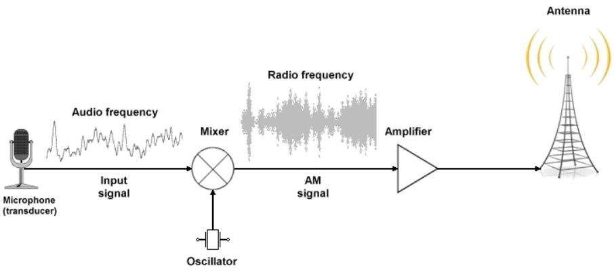
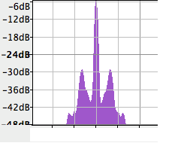




Estación de Radio Amplitud Modulada Estándar
$$1200$$
$$f_{RF, }kHz$$
$$1195$$
$$1205$$

Slide 10
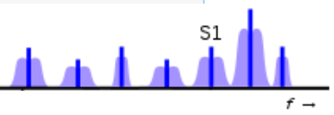
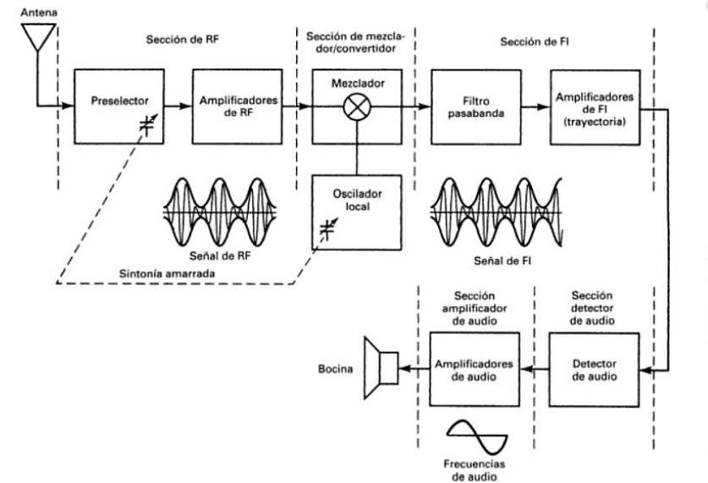
Estaciones de Radio
Sintoniza la estación de radio AM
Receptor AM

Slide 11
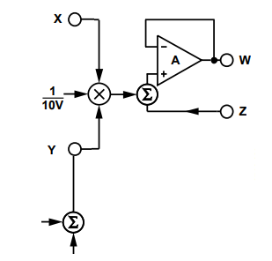






Estaciones de Radio
$$\left[1+\frac{{V_{P}}_{m}}{10}\operatorname{sen}\left(2πf_{m}t\right)\right]{V_{P}}_{c}\operatorname{sen}\left(2πf_{c}t\right)$$
$$\frac{\left\{\left[1+\frac{{V_{P}}_{m}}{10}\operatorname{sen}\left(2πf_{m}t\right)\right]{V_{P}}_{c}\operatorname{sen}\left(2πf_{c}t\right)\right\}\left[{V_{P}}_{c}\operatorname{sen}\left(2πf_{c}t\right)+{V_{p}}_{o}\operatorname{sen}\left(2πf_{o}t\right)\right]}{10}$$
AD633
Portadora o Carrier
Oscilador
Local
$$p\left(t\right)={V_{P}}_{c}\operatorname{sen}\left(2πf_{c}t\right)$$
o$\left(t\right)={V_{p}}_{o}\operatorname{sen}\left(2πf_{o}t\right)$
Frecuencia Local fija $f_{o}=$ 455 kHz
Receptor AM

Slide 12


$$\frac{\left\{\left[1+\frac{{V_{P}}_{m}}{10}\operatorname{sen}\left(2πf_{m}t\right)\right]{V_{P}}_{c}\operatorname{sen}\left(2πf_{c}t\right)\right\}\left[{V_{P}}_{c}\operatorname{sen}\left(2πf_{c}t\right)+{V_{p}}_{o}\operatorname{sen}\left(2πf_{o}t\right)\right]}{10}$$
$$\frac{\left\{{V_{P}}_{c}\operatorname{sen}\left(2πf_{c}t\right)+\frac{{V_{P}}_{c}{V_{P}}_{m}}{20}\cos\left(2π\left[f_{c}−f_{m}\right]t\right)−\frac{{V_{P}}_{c}{V_{P}}_{m}}{20}\cos\left(2π\left[f_{c}+f_{m}\right]t\right)\right\}\left[{V_{P}}_{c}\operatorname{sen}\left(2πf_{c}t\right)+{V_{p}}_{o}\operatorname{sen}\left(2πf_{o}t\right)\right]}{10}$$
$${\left[{V_{P}}_{c}\operatorname{sen}\left(2πf_{c}t\right)\right]}^{2}={{V_{P}}_{c}}^{2}{sen}^{2}\left(2πf_{c}t\right)=\frac{{{V_{P}}_{c}}^{2}}{2}\left(1−\cos\left(4πf_{c}t\right)\right)$$
$${V_{P}}_{c}{V_{P}}_{m}\cos\left(2π\left[f_{c}−f_{m}\right]t\right){V_{P}}_{c}\operatorname{sen}\left(2πf_{c}t\right)=\frac{{{V_{P}}_{c}}^{2}}{2}{V_{P}}_{m}\left[sen\left(2π\left[{2f}_{c}−f_{m}\right]t\right)−sen\left(2π\left[−f_{m}\right]t\right)\right]=\frac{{{V_{P}}_{c}}^{2}}{2}{V_{P}}_{m}\left[sen\left(2π\left[{2f}_{c}−f_{m}\right]t\right)+sen\left(2πf_{m}t\right)\right]$$
$$−{V_{P}}_{c}{V_{P}}_{m}\cos\left(2π\left[f_{c}+f_{m}\right]t\right){V_{P}}_{c}\operatorname{sen}\left(2πf_{c}t\right)=\frac{{{V_{P}}_{c}}^{2}}{2}{V_{P}}_{m}\left[−sen\left(2π\left[{2f}_{c}+f_{m}\right]t\right)+sen\left(2πf_{m}t\right)\right]$$
$${V_{P}}_{c}\operatorname{sen}\left(2πf_{c}t\right){V_{P}}_{o}\operatorname{sen}\left(2πf_{o}t\right)=\frac{{V_{P}}_{c}}{2}{V_{P}}_{o}\left[\cos\left(2π\left[f_{c}−f_{o}\right]t\right)−\cos\left(2π\left[f_{c}+f_{o}\right]t\right)\right]$$
$${V_{P}}_{c}{V_{P}}_{m}\cos\left(2π\left[f_{c}−f_{m}\right]t\right){V_{P}}_{o}\operatorname{sen}\left(2πf_{o}t\right)=\frac{{V_{P}}_{c}}{2}{V_{P}}_{o}{V_{P}}_{m}\left[sen\left(2π\left[f_{c}−f_{m}+f_{o}\right]t\right)−sen\left(2π\left[f_{c}−f_{m}−f_{o}\right]t\right)\right]$$
$$−{V_{P}}_{c}{V_{P}}_{m}\cos\left(2π\left[f_{c}+f_{m}\right]t\right){V_{P}}_{o}\operatorname{sen}\left(2πf_{o}t\right)=\frac{{V_{P}}_{c}}{2}{V_{P}}_{o}{V_{P}}_{m}\left[−sen\left(2π\left[f_{c}+f_{m}+f_{o}\right]t\right)∓sen\left(2π\left[f_{c}+f_{m}−f_{o}\right]t\right)\right]$$

Slide 13



Radio América
Radio Cartago
Radio CR
Cú Cú
FCN
Radio 16
$$f_{c}=1200 kHz$$
Heterodinas
$$f_{m}=5 kHz$$
2395 kHz | 2400 kHz | 2405 kHz
1650 kHz | 1655 kHz | 1660 kHz
740 kHz | 745 kHz | 750 kHz
530 KHz
700
780
850
930
1200
1590
1600 KHz
$$f_{o}=455 kHz$$
$${\left[{V_{P}}_{c}\operatorname{sen}\left(2πf_{c}t\right)\right]}^{2}=\frac{{{V_{P}}_{c}}^{2}}{2}\left(1−\cos\left(2π[2400kHz]t\right)\right)$$
$$\frac{{{V_{P}}_{c}}^{2}}{2}{V_{P}}_{m}\left[sen\left(2π\left[{2f}_{c}−f_{m}\right]t\right)+sen\left(2πf_{m}t\right)\right]=\frac{{{V_{P}}_{c}}^{2}}{2}{V_{P}}_{m}\left[sen\left(2π\left[2395kHz\right]t\right)+sen\left(2π[5kHz]t\right)\right]$$
$$−\frac{{{V_{P}}_{c}}^{2}}{2}{V_{P}}_{m}\left[sen\left(2π\left[{2f}_{c}+f_{m}\right]t\right)−sen\left(2πf_{m}t\right)\right]=\frac{{{V_{P}}_{c}}^{2}}{2}{V_{P}}_{m}\left[−sen\left(2π\left[2405kHz\right]t\right)+sen\left(2π[5kHz]t\right)\right]$$
$$\frac{{V_{P}}_{c}}{2}{V_{P}}_{o}\left[\cos\left(2π\left[f_{c}−f_{o}\right]t\right)−\cos\left(2π\left[f_{c}+f_{o}\right]t\right)\right]=\frac{{V_{P}}_{c}}{2}{V_{P}}_{o}\left[\cos\left(2π\left[745kHz\right]t\right)−\cos\left(2π\left[1655kHz\right]t\right)\right]$$
$$\frac{{V_{P}}_{c}}{2}{V_{P}}_{o}{V_{P}}_{m}\left[sen\left(2π\left[f_{c}−f_{m}+f_{o}\right]t\right)−sen\left(2π\left[f_{c}−f_{m}−f_{o}\right]t\right)\right]=\frac{{V_{P}}_{c}}{2}{V_{P}}_{o}{V_{P}}_{m}\left[sen\left(2π\left[1650kHz\right]t\right)−sen\left(2π\left[740kHz\right]t\right)\right]$$
$$\frac{{V_{P}}_{c}}{2}{V_{P}}_{o}{V_{P}}_{m}\left[sen\left(2π\left[f_{c}+f_{m}+f_{o}\right]t\right)−sen\left(2π\left[f_{c}+f_{m}−f_{o}\right]t\right)\right]=\frac{{V_{P}}_{c}}{2}{V_{P}}_{o}{V_{P}}_{m}\left[−sen\left(2π\left[1660kHz\right]t\right)+sen\left(2π\left[750kHz\right]t\right)\right]$$

Slide 14
2395 kHz | 2400 kHz | 2405 kHz
1650 kHz | 1655 kHz | 1660 kHz
740 kHz | 745 kHz | 750 kHz
Estaciones de Radio
$$\left[1+\frac{{V_{P}}_{m}}{10}\operatorname{sen}\left(2πf_{m}t\right)\right]{V_{P}}_{c}\operatorname{sen}\left(2πf_{c}t\right)$$
$$\frac{\left\{\left[1+\frac{{V_{P}}_{m}}{10}\operatorname{sen}\left(2πf_{m}t\right)\right]{V_{P}}_{c}\operatorname{sen}\left(2πf_{c}t\right)\right\}\left[{V_{P}}_{c}\operatorname{sen}\left(2πf_{c}t\right)+{V_{p}}_{o}\operatorname{sen}\left(2πf_{o}t\right)\right]}{10}$$
AD633
Portadora o Carrier
Oscilador
Local
$$p\left(t\right)={V_{P}}_{c}\operatorname{sen}\left(2πf_{c}t\right)$$
o$\left(t\right)={V_{p}}_{o}\operatorname{sen}\left(2πf_{o}t\right)$
Frecuencia Local fija $f_{o}=$ 455 kHz
Receptor AM

Slide 15
Estaciones de Radio
Sintoniza la estación de radio AM
2395 kHz | 2400 kHz | 2405 kHz
1650 kHz | 1655 kHz | 1660 kHz
740 kHz | 745 kHz | 750 kHz
RF
FI
high-side injection
FI
low-side injection
Receptor AM

Slide 16



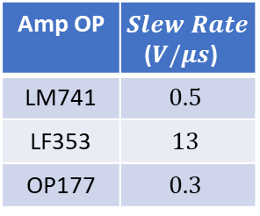
Estación de Radio Amplitud Modulada Estándar
$$1200$$
$$f_{RF, }kHz$$
$$1195$$
$$1205$$
Slew Rate?
$$V$$
$$1200 kHz$$
$$1195 kHz$$
Amp OP | $Slew Rate$($V/μs$)
LM741 | $$0.5$$
LF353 | $$13$$
OP177 | $$0.3$$
Amp OP | $Slew Rate$($V/μs$)
LM741 | $$0.5$$
LF353 | $$13$$
OP177 | $$0.3$$
LH0024 | 500
$$1205 kHz$$
$$f$$
$$t$$

